Slide 1
Ch07 Error and Exception Handling
Highlights of the chapter:
7.1 Errors in the program
7.2 Exception handling
7.3 Assertion Handling
7.4 Basic debugging methods for programs
7.5 Logging with the logging module
7.6 Integrated Applications: Error and Exception Handling

Slide 2
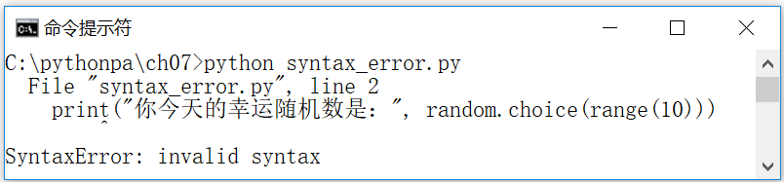
Errors in the program
Syntax errors, runtime errors and logic errors
Syntax errors are spelling syntax errors in its source code that cause the Python compiler to fail to convert the Python source code to byte code, so they are also called compilation errors
[Example 7.1] Python syntax error example (syntax_error.py)
print("Good Luck!"
print("Your lucky random number today is:", random.choice(range(10)))

Slide 3
run-time error (in computing)
The runtime error is in the
If the program does not import the relevant module (e.g., import random), the interpreter will throw a NameError error message at runtime
Programs that include zero division operations will throw a ZeroDivisionError error message at runtime by the interpreter
Attempting to open a non-existent file in a program will cause the interpreter to throw a FileNotFoundError error message at runtime

Slide 4
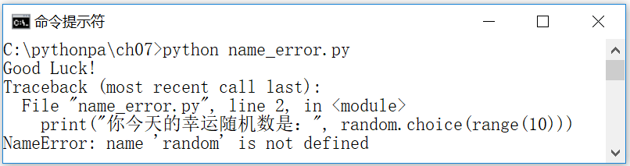
[Example 7.2] Python Runtime Error (No Related Module Imported)
print("Good Luck!")
print("Your lucky random number today is:", random.choice(range(10)))

Slide 5
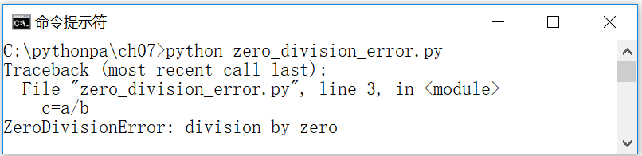
[Example 7.3] Python Runtime Errors (Division by Zero Errors)
a=1
b=0
c=a/b

Slide 6
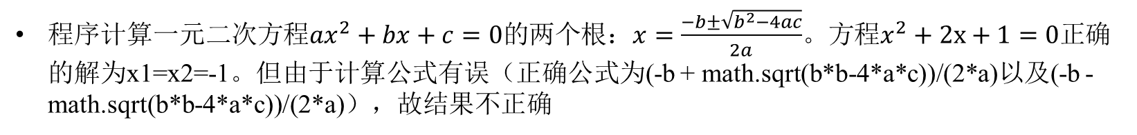
logical error
A logical error is a program that can be executed (the program run itself does not report an error), but the result of the execution is incorrect. The Python interpreter can't do anything about logical errors, so the reader needs to debug the program based on the results.
[Example 7.4] Python Logic Error Example
import math
a=1; b=2; c=1
x1 = -b + math.sqrt(b*b-4*a*c)/2*a # There is an error in the formula, so the result is incorrect
x2 = -b - math.sqrt(b*b-4*a*c)/2*a # the formula is wrong, so the result is incorrect
print(x1, x2) #Output: -2.0 -2.0

Slide 7
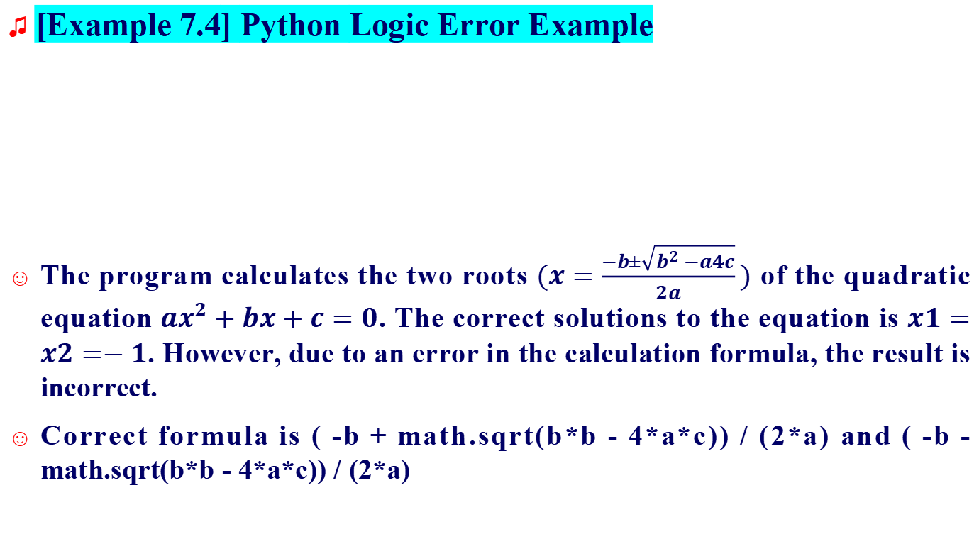
logical error
[Example 7.4] Python Logic Error Example
The program calculates the two roots $(x=\frac{−b±\sqrt{b^{2}−a4c}}{2a})$ of the quadratic equation $ax^{2}+bx+c=0$. The correct solutions to the equation is $x1=x2=−1$. However, due to an error in the calculation formula, the result is incorrect.
Correct formula is ( -b + math.sqrt(b*b - 4*a*c)) / (2*a) and ( -b - math.sqrt(b*b - 4*a*c)) / (2*a)
import math
a=1; b=2; c=1
x1 = -b + math.sqrt(b*b-4*a*c)/2*a # There is an error in the formula, so the result is incorrect
x2 = -b - math.sqrt(b*b-4*a*c)/2*a # the formula is wrong, so the result is incorrect
print(x1, x2) #Output: -2.0 -2.0

Slide 8
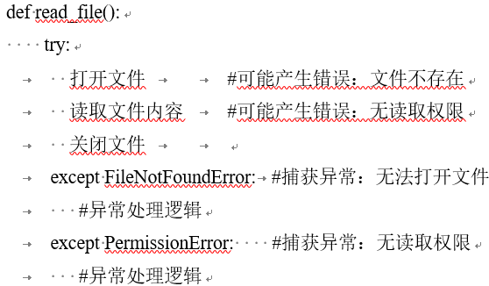
Exception handling
The try statement defines a block of code to run the code that may throw an exception; the except statement allows you to catch specific exceptions and perform the appropriate handling; the finally statement ensures that even if an exception is thrown (handling fails), you can clean up the resources, etc., afterward.

Slide 9
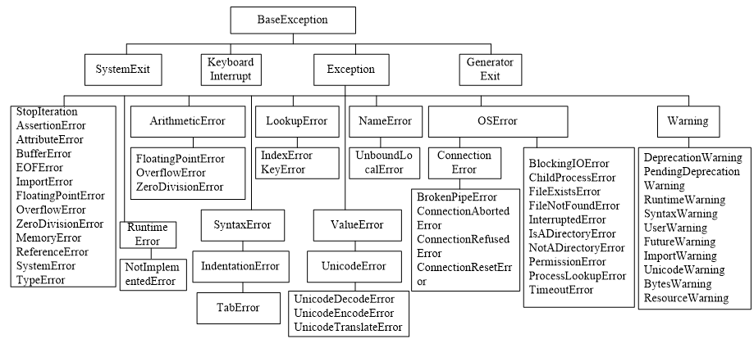
Built-in exception classes

Slide 10
[Example 7.5] Common Exception Example (1)
(1) NameError. attempts to access an unasserted variable.
>>> noname #Error. nameError: name 'noname' is not defined
(2) SyntaxError. syntax error.
>>> int a # Error reported. SyntaxError: invalid syntax
(3) AttributeError. accessing an unknown object attribute.
>>> a=1
>>> a.show() #Error reported. AttributeError: 'int' object has no attribute 'show'
(4) TypeError. type error.
>>> 11 + 'abc' #Error. typeError: unsupported operand type(s) for +: 'int' and 'str'
(5) ValueError. value error.
>>> int('abc') #Error reported. valueError: invalid literal for int() with base 10: 'abc'

Slide 11
[Example 7.5] Common Exception Example (2)
(6) ZeroDivisionError.
>>> 1/0 #Error. zeroDivisionError: division by zero
(7) IndexError. index out of range.
>>> a=[10,11,12]
>>> a[3] # report error. indexError: list index out of range
(8) KeyError. dictionary keyword does not exist.
>>> m = {'1':'yes', '2':'no'}
>>> m['3'] #Error reported. keyError: '3'

Slide 12
cause anomalies
Most errors and exceptions generated by program bugs are generally thrown automatically by the Python virtual machine
If you determine an error condition, you can create an object of the corresponding exception class and throw it with the raise statement
[Example 7.6] Python Virtual Machine Automatically Throws Exceptions Example
Example 7.7: Throwing an Exception in Program Code with the Raise Statement
>>> 1/0 #Error. zeroDivisionError: division by zero
>>> if a<0: raise ValueError("Value cannot be negative")
The program will run and display the error message "ValueError: value cannot be negative".

Slide 13
Python Virtual Machine Catch Handling Exceptions
[Example 7.8] Python Virtual Machine Catch Handling Exception Example (pvmexcept.py)
i1 = 1
i2 = 0
print(i1/i2)
The program will display the error message "ZeroDivisionError: division by zero" after running.

Slide 14
Catching and handling exceptions with try...except...else...finally statements
try:
the statements may cause exception
except Exception1: # Catch exception Exception1
the statements will be executed when exception occurs
except (Exception2, Exception3): # Catch exception Exception2, Exception3
the statements will be executed when exception occurs
except Exception4 as e: # Catch exception Exception4 which instance is e
the statements will be executed when exception occurs
except: # Catch all other exceptions
the statements will be executed when exception occurs
else: # No exceptions
the statements will be executed when no exceptions
finally: # Statements that are guaranteed to execute
Statements that are guaranteed to execute regardless of an exception.

Slide 15
The form of the try statement
(1) try…except…[else…]: a try block followed by one or more except blocks, else block is available too
(2) try…finally: a try block followed by a finally block
(3) try…except…finally: a try block followed by one or more except blocks, else block is available too, followed by a finally block
Use try... .except... .else... . finally statement, you can also rethrow the exception, i.e., handle part of the exception, and then rethrow it using the raise statement in order to call other exception handlers on the stack to catch and handle it...
[Example 7.9] try...except...else...finally example (try_except.py)
try.
f = open("testfile.txt", "w")
f.write("This is a test file for testing exceptions!!!")
f1 = open("testfile1.txt", "r") #Error: no file found or failed to read file
except IOError.
print("File not found or reading file failed")
else.
print("File written successfully!")
finally.
f.close()

Slide 16
The form of the try statement
[Example 7.9] try...except...else...finally example (try_except.py)
try:
f = open("testfile.txt", "w")
f.write("This is a test file for testing exceptions!!!")
f1 = open("testfile1.txt", "r") #Error: no file found or failed to read file
except IOError:
print("File not found or reading file failed")
else:
print("File written successfully!")
finally:
f.close()

Slide 17
The order in which exceptions are caught
The except block catches and handles a specific type of exception (this type is called an "exception filter"), and multiple except blocks with different exception filters can be chained together.
[Example 7.10] Example of Exception Class Position Order (try_except2.py): The highly derived exception class NumberError is placed after the lesser derived Exception, causing the program to never catch it.
a = (44, 78, 90, -80, 55)
total = 0
try.
for i in a:
if i < 0: raise ValueError(str(i)+"negative")
total += i
print('Total=', total)
except Exception.

Slide 18
The order in which exceptions are caught
[Example 7.10] Example of Exception Class Position Order (try_except2.py): The highly derived exception class NumberError is placed after the lesser derived Exception, causing the program to never catch it.
a = (44, 78, 90, -80, 55)
total = 0
try.
for i in a:
if i < 0: raise ValueError(str(i)+"negative")
total += i
print('Total=', total)
except Exception.
print('An exception occurred')
except ValueError.
print('Values cannot be negative')
Exception is the parent class of all derived classes in the program, so it will be caught and handled first, outputting the message "An exception has occurred"; while the subsequent exception ValueError cannot be caught. The order of the two should be exchanged

Slide 19
Finally blocks and handling of exceptions when they occur
The finally block is always executed after the execution of the try and except blocks, regardless of whether an exception is thrown or an except block matching the type of the exception is found.
The finally block is used to clean up operations performed in the try block, such as releasing the resources it occupies (e.g., file streams, database connections, and graphic handles), without having to wait for the garbage collector in the runtime library to finish the object.

Slide 20
Finally blocks and handling of exceptions when they occur
[Example 7.11] Example of code that is guaranteed to execute using the finally statement (try_finally.py). Write the input string to text until you press Q to finish. If you press Ctrl+C to interrupt the program run, you are also guaranteed to close the open file normally
try.
f = open('mytext.txt', 'w') #Open the file to be written to
while True:
s = input('Please enter a string (press Q to end):')
if s.upper() == 'Q': break
f.write(s + '\n')
except KeyboardInterrupt.
print('Program interrupt! (Ctrl-C)')
finally.
f.close()

Slide 21
Customized Exception Classes
Custom exception classes generally inherit from Exception or its subclasses. The naming convention for custom exception classes is generally Error or Exception suffixes
[Example 7.12] Create a custom exception (NumberError.py) that handles exceptions in applications with negative parameters (e.g., a student grade processing class that cannot allow negative grades)

Slide 22
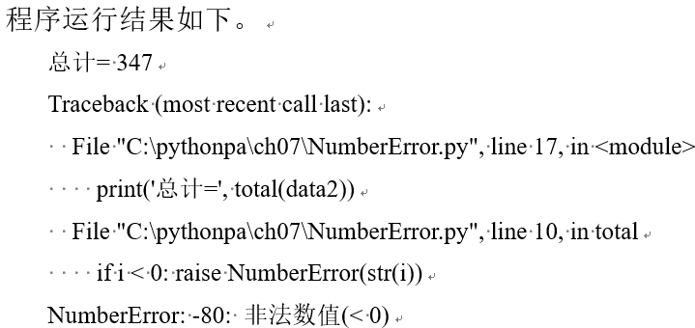
Customized Exception Classes
[Example 7.12] Create a custom exception (NumberError.py) that handles exceptions in applications with negative parameters (e.g., a student grade processing class that cannot allow negative grades)
class NumberError(Exception): # Custom exception class, inherits from Exception.
def __init__(self,data).
Exception.__init__(self, data)
self.data = data
def __str__(self): #Overload the __str__ method
return self.data + ': illegal value (< 0)'
def total(data).
total = 0
for i in data:
if i < 0: raise NumberError(str(i))
total += i
return total
# Test code
data1 = (44, 78, 90, 80, 55)
print('total=', total(data1))
data2 = (44, 78, 90, -80, 55)
print('total=', total(data2))

Slide 23
assertion processing
Assertions are generally used in the following situations
The main function of assertions is to help programmers debug the program to ensure that the program runs correctly; assertions are generally used in the development and debugging phase. That is, when the debugging mode assertions are valid, the optimization mode runs, automatically ignoring the assertions
(1) Pre-conditional assertions: properties that must be present before the code is executed
(2) Postconditional assertion: a characteristic that must be present after code execution.
(3) Pre- and Post-Invariant Assertion: Characteristics that cannot be changed before or after code execution.

Slide 24
Assert Statements and AssertionError Classes
assert <boolean expression> # simple form
assert <boolean expression>, <string expression> # form with parameters
The Python interpreter has two modes of operation: debug mode and optimization mode. Normally debug mode, the built-in read-only variable __debug__ is True
Running with the -O option (i.e., python.exe -O) is optimized mode, where the built-in read-only variable __debug__ is False

Slide 25
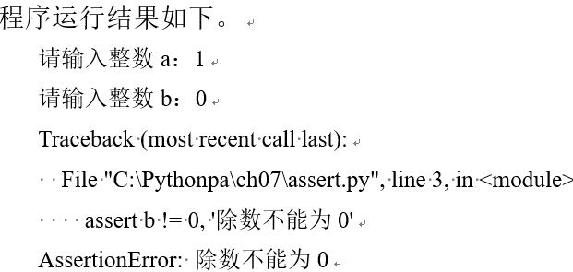
Assert Statements and AssertionError Classes
[Example 7.13] Assertion Example (assert.py)
a = int(input("Please enter the integer a:"))
b = int(input("Please enter the integer b:"))
assert b ! = 0, 'Divisor cannot be 0'
c = a / b
print(a, '/', b, '=', c)

Slide 26
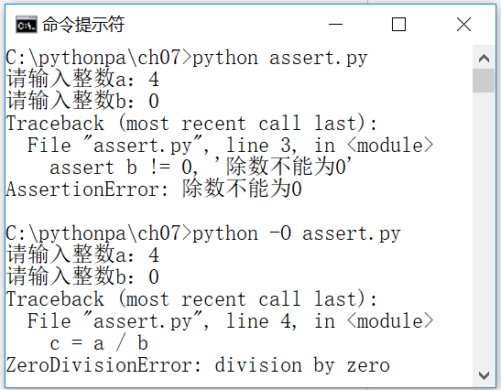
Enable/disable assertions
Typically python runs in debug mode, and assertions in the program can help with debugging.
When running formally, use the run option -O to run in optimized mode to disable assertions, thus improving program efficiency
[Example 7.14]: Enabling/Disabling the Assertion Option: Running Example 7.13 in two separate modes
Command line command: python assert.py
Command line command: python -O assert.py

Slide 27
Enable/disable assertions
[Example 7.14]: Enabling/Disabling the Assertion Option: Running Example 7.13 in two separate modes
Command line command: python assert.py
Command line command: python -O assert.py

Slide 28
Basic debugging methods for programs
>>> if 1 > 2 # Error reported. SyntaxError: invalid syntax
>>> Print('abc') #Error. nameError: name 'Print' is not defined
>>> x #Error. NameError: name 'x' is not defined
Debugging of syntax errors
Based on the exceptions thrown by the Python interpreter, determine the reason for the exception, respectively:
The SyntaxError generated by the first statement indicates a syntax error (no colon after the if compound statement)
The second statement produces a NameError indicating a name error (misspelled, should be print)
The third statement produces a NameError indicating a name error (undefined variable)

Slide 29
Debugging of runtime errors
[Example 7.15] Runtime Error Debugging Example
>>> f = open('abc.txt') #File or directory does not exist: FileNotFoundError
>>> a=1;b=0
>>> c=a/b #ZeroDivisionOverflow: ZeroDivisionError
>>> 123 + 'abc' # TypeError: unsupported operand type(s) for +: 'int' and 'str'
Based on the exceptions thrown by the Python interpreter at runtime, determine the reason for the exception, respectively:
The first statement produces a FileNotFoundError indicating the opening of a non-existent file.
The ZeroDivisionError generated by the third statement indicates a zero division error
The TypeError generated by the fourth statement indicates that the values of objects of different types cannot be added together.

Slide 30
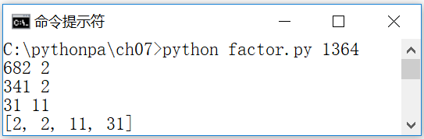
Debugging of logic errors
Methods such as breakpoint tracking, outputting information
There are integrated development environments (IDEs) that allow you to set breakpoints and view variables, etc.
Outputting the values of variables (trace information) during the running of a program through the print statement is an effective method of observing and debugging the correctness of the program's running logic.
[Example 7.16] Tracing Logic Errors through Output Messages Debugging Example (factor.py). Decompose the integer entered as a command line argument into a product of prime numbers
import sys
n = int(sys.argv[1])
result=[]
factor = 2
while factor*factor <= n.
while (n % factor) == 0.
n //= factor
result.append(factor)
print(n, factor)
factor += 1
if n > 1.
result.append(n)
print(result)

Slide 31
Logging with the logging module
The Python standard library provides the module logging for logging.
Using Python's standard logging module, you can flexibly configure the level of output messages in your programs and libraries to filter out messages that are not important; configure the format and content of the output messages; and configure where the logs will be output (e.g., console, file, etc.)

Slide 32
Logging module components
(1) Logger: logging interface, used to configure and send log messages. You can logging.getLogger(name) to get the logger object, if you do not specify the name of the return to the root object
(2) Handler: log processor, the log record (log record) to the destination (destination, such as files, sockets, etc.). A logger object can be added through the addHandler method zero or more handler, each handler can define a different log level, in order to achieve the log hierarchy filtering records
(3) Filter: log filter, determines whether a log record is sent to the handler in a way
(4) Formatter: log formatting, formatting the log to be recorded. Its constructor includes two optional parameters: the format of the message string and date string

Slide 33
Configuration and use of logging
The basic steps to configure logging using Python code are as follows.
(1) Create the logger object. For example:
logger = logging.getLogger('log_test') #Get the logger object named log_test
logger.setLevel(logging.DEBUG) #set logging level
(2) Create a handler object. For example:
fh = logging.FileHandler('log_test.log') #create file handler object to log details
fh.setLevel(logging.DEBUG)
ch = logging.StreamHandler() # create a console handler that outputs error messages
ch.setLevel(logging.ERROR)
(3) Create a formatter object and associate it with a handler object. For example:
formatter = logging.Formatter('%(asctime)s - %(name)s - %(levelname)s - %(message)s')
fh.setFormatter(formatter)
ch.setFormatter(formatter)
(4) Add the handler object to the logger object. Example:
logger.addHandler(fh)
logger.addHandler(ch)
(5) Use the methods of the logger object in your program to output log messages. Example:
logger.debug("debugging information")
logger.info("General Information")
logger.warning("Warning message")
logger.error("Error message")
logger.critical("Critical message")

Slide 34
Easy Configuration Log
Logging can also be conveniently configured using logging.basicConfig()
logging.basicConfig(level = logging.INFO,
format = '%(asctime)s - %(name)s - %(levelname)s - %(message)s')
Then use the functions of the logging module to output log messages. Example:
logging.debug("debugging information")
logging.info("General Information")
logging.warning("Warning message")
logging.error("Error message")
logging.critical("Critical message")

Slide 35

Easy Configuration Log
[Example 7.17] Outputting directly to the console using the default configuration
import logging
logging.debug("debugging information") #will not be outputted
logging.info("General Information")
logging.warning("Warning message")
logging.error("Error message")
logging.critical("Critical error")

Slide 36

Example 7.18: Configuring Logging to the Console with basicConfig
import logging
# Configure logging
logging.basicConfig(level = logging.INFO
,format = '%(asctime)s - %(name)s - %(levelname)s - %(message)s')
# Output log messages
logging.debug("debugging information") #will not be outputted
logging.info("General Information")
logging.warning("Warning message")
logging.error("Error message")
logging.critical("Critical error")

Slide 37
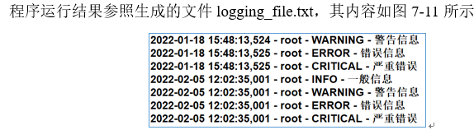
Example 7.19: Configuring Logging to a File with basicConfig
import logging
# Configure logging
logging.basicConfig(filename="logging_file.txt", level = logging.INFO,
format = '%(asctime)s - %(name)s - %(levelname)s - %(message)s')
# Output log messages
logging.debug("debugging information")
logging.info("General Information")
logging.warning("Warning message")
logging.error("Error message")
logging.critical("Critical error")

Slide 38

Example 7.20: Output log messages to a file and error messages to the console.
import logging
# Configure logging
logger = logging.getLogger(__name__)
logger.setLevel(level=logging.DEBUG)
handler = logging.FileHandler("logging_console_file.txt")
handler.setLevel(logging.DEBUG)
formatter = logging.Formatter('%(asctime)s - %(name)s - %(levelname)s - %(message)s')
handler.setFormatter(formatter)
console = logging.StreamHandler()
console.setLevel(logging.ERROR)
logger.addHandler(handler)
logger.addHandler(console)
# Output log messages
logger.debug("debugging information")
logger.info("General Information")
logger.warning("Warning message")
logger.error("Error message")
logger.critical("Critical error")

Slide 39
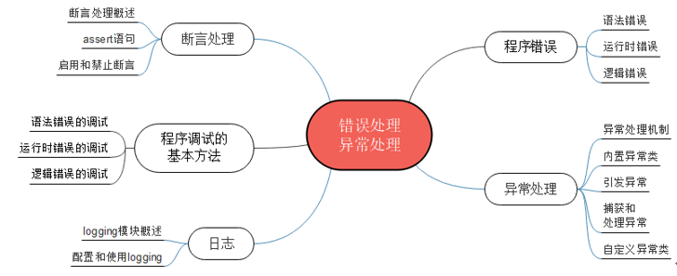
Summary of the chapter

Slide 40
Integrated applications: error and exception handling (1)
[Example 7.21] Write a Python program (add_int_with_exception.py) that prompts the user to enter two integers and outputs the result of adding the two integers. However, if the input is not an integer (e.g., a letter, a floating-point number, etc.), the program is required to catch an exception that displays "Input must be an integer!" and prompts the user to re-enter until the input is correct.
def get_number(): #Function to get an integer input
num = 0
while True: # keep looping
try.
num = int(input("Please enter an integer:"))#Prompt the user to enter an integer
except ValueError.
print("Input must be an integer!") #If the input is not an integer, an exception is caught and an error is reported.

Slide 41
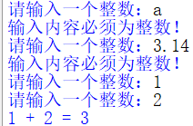
Integrated applications: error and exception handling (2)
def get_number(): #Function to get an integer input
num = 0
while True: # keep looping
try.
num = int(input("Please enter an integer:"))#Prompt the user to enter an integer
except ValueError.
print("Input must be an integer!") #If the input is not an integer, an exception is caught and an error is reported.
else.
break # Jump out of the while loop
return num
a = get_number() # integer 1
b = get_number() # integer 2
print(f"{a} + {b} = {a+b}") #The result of adding two integers.

Slide 42
Integrated applications: error and exception handling (3)
[Example 7.22]: Write a Python program (open_with_exception.py) that prompts the user to enter a file pathname or filename, tries to open the file, and outputs the contents of the file on the screen; if the specified file doesn't exist, it displays the message "File not found!" and asks for a new filename; if the file exists but an exception occurs during the reading process, it displays the message "File cannot be read out properly! and ask to re-enter the file name; if the file exists but an exception occurs in the process of reading the file, it will display "The file cannot be read out normally! and ask to retype the file name.

Slide 43
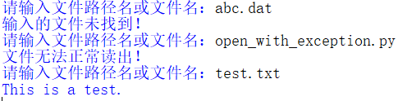
Integrated applications: error and exception handling (4)
while True: # keep looping
try.
filename = input('Please enter a file pathname or filename:') #Prompt the user for a filename
with open(filename.strip()) as f: #Open the file (using the default text-reading mode)
print(f.read()) #Display the contents of the file
except FileNotFoundError:
print("Input file not found!") # Handle file not found exception
except.
print("The file could not be read out properly!") # Handle other exceptions
else.
break # Jump out of the while loop
During the testing of this program, three files were entered for testing.
(1) First, the user enters a non-existent file abc.dat, so the program catches an exception and reports the error "Input file not found!". .
(2) Next, the user enters the program's filename, open_with_exception.py, and the program still catches the exception and reports the error "The file could not be read out properly!". The program still catches the exception and reports the error "The file could not be read out properly!". This is because there are Chinese characters in the program file.
(3) Finally, the user inputs a file test.txt containing only English characters, so the program outputs the contents of the file on the screen

Slide 44
Case Study: Debugging Python Programs with the Debugger
Analyzing and locating program errors is the most basic function of programming. pdb, the debugger of the Python standard library, provides basic debugging functions: setting breakpoints, viewing variables, etc.
Integrated development environments (IDEs, e.g. IDLE, Spyder, PyCharm) provide a more direct and convenient debugger.
This case study illustrates the basic approach to tracing and debugging a Python program using the IDLE debugger through examples
The solution and source code etc. of the case studies are provided in electronic format, please scan the QR code in the tutorial for details

Slide 45
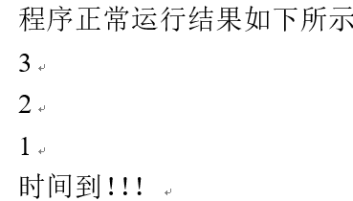
[Example CS7.1] Countdown applet (countdown.py)
Recursive function applet. (The program simulates a countdown)
import time
def countdown(n).
"""Count backwards from n to 0.""""
if n <= 0: #basic
print("Time!!!")
else: #recursive step
time.sleep(1) # sleep for 1 second
print(n) #Output the reciprocal number
countdown(n-1) #recursive call
if __name__ == "__main__".
countdown(3)

Slide 46
[Example CS7.2] Using the IDLE Debugger to Debug and Run Programs Sample Program countdown.py
(1) Run IDLE and open the program source code, countdown.py.
(2) Set breakpoints. In the statement you want to debug, through the right mouse button shortcut menu [Set Breakpoint] to set breakpoints, set the breakpoints of the code line background color is yellow, you can also clear the breakpoints have been set through the [Clear Breakpoint]!
(3) Open the debugger. In the IDLE window, press the shortcut key [F5], the program starts to run. In the pop-up Python interpreter command line window, by executing the menu command [Debug] | [Debugger], open the debugger window
(4) Debugging to run the program. In the IDLE window, press the shortcut key [F5] and the program starts to run. The program interrupts and pauses at the first line of code. The bottom color of the code is gray for the current execution of the code line. Users can use the [Debug Control] window to view the running state of the program (call stack Stack, local variables Locals, global variables Globals), to perform the next debugging commands
(5) In the [Debug Control] window, click to run the debugging command [Go], so that the program runs to the next breakpoint to interrupt and pause.

Slide 47
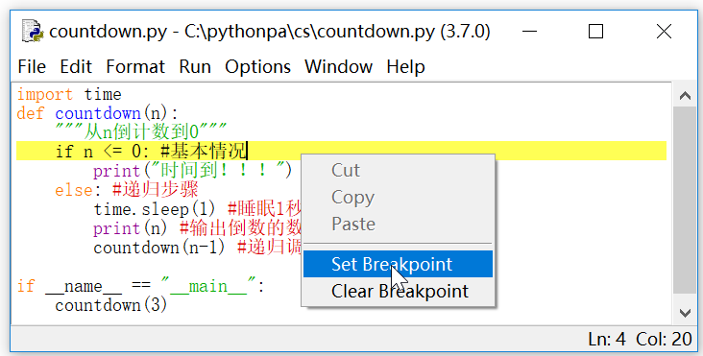
[Example CS7.2] Using the IDLE Debugger to Debug and Run Programs Sample Program countdown.py
(6) View the running state of the program. View the local variables Locals and the global variable Globals. n is 3 at this time
(7) In the [Debug Control] window, click on the debugging command [Over] and execute the command in a single step. As n is 3, so the program jumps to the first statement after the else
(8) Continue to execute other debugging commands

Slide 48
Thank!

